Slide 1
Data Camp - Intermediate Python for Data Science Chapter 4: Loops
DATA SWAT
November 29, 2016
Aryn Moore

Slide 2
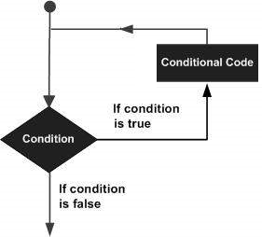
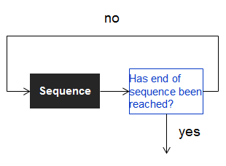
Overview
Python loops execute a statement or group of statements multiple times until the condition(s) is/are met.
Can nest multiple loops within one another
while loop
repeated if statement performed while condition is true
TIP: Use ctrl + c to interrupt a permanent loop.
for loop
Executes a sequence of statements multiple times
until end of sequence is reached.
Iterates over all kinds of data structures
while condition :
expression
for var in seq :
expression

Slide 3
while loop conditionals (if/else statements)
while this condition is true:
execute this thing
if condition, while true, is one thing :
then do this
else :
do a different thing
In [1]: offset = -6
In [2]: while offset != 0 :
if offset > 0 :
offset = offset - 1
else :
offset = offset + 1
print(offset)
Out[2]: -5
-4
-3
-2
-1
0
In [3]: offset = 6
In [4]: while offset != 0 :
if offset > 0 :
offset = offset - 1
else :
offset = offset + 1
print(offset)
Out[4]: 5
4
3
2
1
0

Slide 4
enumerate
enumerate: index the values being printed in the loop
In [1]: areas = [11.25, 18.0, 20.0, 10.75, 9.50]
In [2]: for index, area in enumerate(areas) :
print (index, area)
Out[2]: 0 11.25
1 18.0
2 20.0
3 10.75
4 9.5

Slide 5
enumerate continued
In [3]: areas = [11.25, 18.0, 20.0, 10.75, 9.50]
In [4]: for index, a in enumerate(areas) :
print("room " + str(index) + ": " + str(a))
Out[4]: room 0: 11.25
room 1: 18.0
room 2: 20.0
room 3: 10.75
room 4: 9.5
In [5]: areas = [11.25, 18.0, 20.0, 10.75, 9.50]
In [6]: for index, a in enumerate(areas) :
print("room " + str(index + 1) + ": " + str(a))
Out[6]: room 1: 11.25
room 2: 18.0
room 3: 20.0
room 4: 10.75
room 5: 9.5

Slide 6
for loop over list of lists
x represents each sub-list. Index each sub-list using x to loop over and print the objects you want.
In [7]: house = [["hallway", 11.25],
["kitchen", 18.0],
["living room", 20.0],
["bedroom", 10.75],
["bathroom", 9.50]]
In [8]: for x in house :
print("the " + x[0] + " is " + str(x[1]) + " sqm")
Out[8]: the hallway is 11.25 sqm
the kitchen is 18.0 sqm
the living room is 20.0 sqm
the bedroom is 10.75 sqm
the bathroom is 9.5 sqm
TIP: the +’s are very important. You will get a syntax error if you forget any.

Slide 7
Looping Dictionaries
for key, value in dict_name.items() :
print()
Filip says that the order in which dictionary key/value pairs are iterated over is not fixed because a dictionary is inherently unordered
In [9]: world = { "afghanistan":30.55,
"albania":2.77,
"algeria":39.21 }
In [10]: for key, value in world.items() :
print(key + " -- " + str(value))
Out[10]: algeria -- 39.21
afghanistan -- 30.55
albania -- 2.77
When I ran the same code, it was iterated over in the same order every time, but in a different order than Filip got (Afghanistan, Albania, Algeria - alphabetical)
method

Slide 8
Looping Numpy Arrays
for val in np.nditer(array_name) :
Gives out every object in the array in a single list.
Function
In [4]: np_baseball
Out[4]:
array([[ 74, 180],
[ 72, 215],
...,
[ 75, 190],
[ 73, 195]])
In [5]: for x in np.nditer(np_baseball) :
print(x)
Out[5]: 74
72
...
75
73
...
180
215
...
190
195

Slide 9
Looping Pandas Data Frames
In Pandas you have to mention explicitly that you want to iterate over the rows
Generates label of row, and the data in the row as a series
Can specify which column(s) you want row data from
for lab, row in data_frame.iterrows() :
print(lab)
print(row)

